Slide 1





Boosting powers by combining spatial econometrics with dyadic analysis and SEM. Racial/ethnic differences in life expectancy across the US states
Methodological Innovation - Modern Modeling Methods, Storrs, CT, June 26-28 2023
Slides at
Data shared at
Emil Coman^{P}, Adrian-Gabriel Enescu², Peter Chen³, Sandro Steinbach⁴
^{P}: Health Disparities Institute, UConn School of Medicine; ²: Univ. of Brasov, Romania, Economics, ³: Uconn Geography; ⁴: Uconn Agricultural Economics; coman@uchc.edu
Notes:
P = presenter

Slide 2
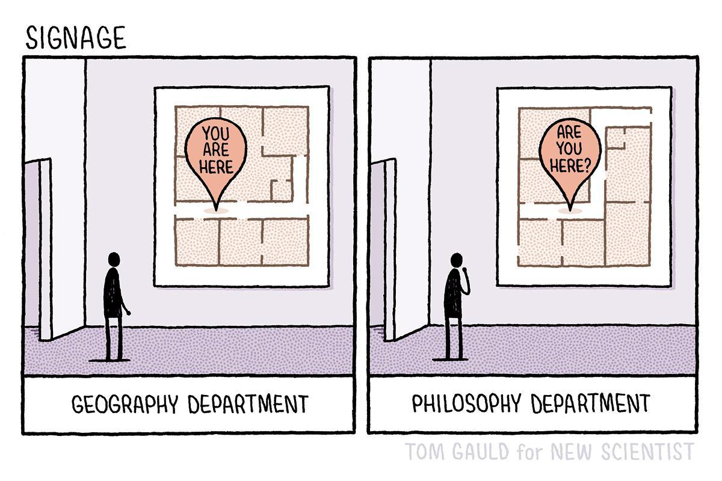
What would your department say?
2

Slide 3
General plan
1. Challenges of spatial data and analytics and solutions
2. Applying path analysis to spatial data: naïve/a-spatial vs. spatial modeling
3. A modern spatial twist of a statistical fix for auto-correlated data – dyadic non-independence
4. Dyadic analysis and Gonzalez and Griffin approach
5. ‘Auto’-correlations and interference: causality
6. Future extensions: 1-to-many relations; spatial factor analysis
3

Slide 4
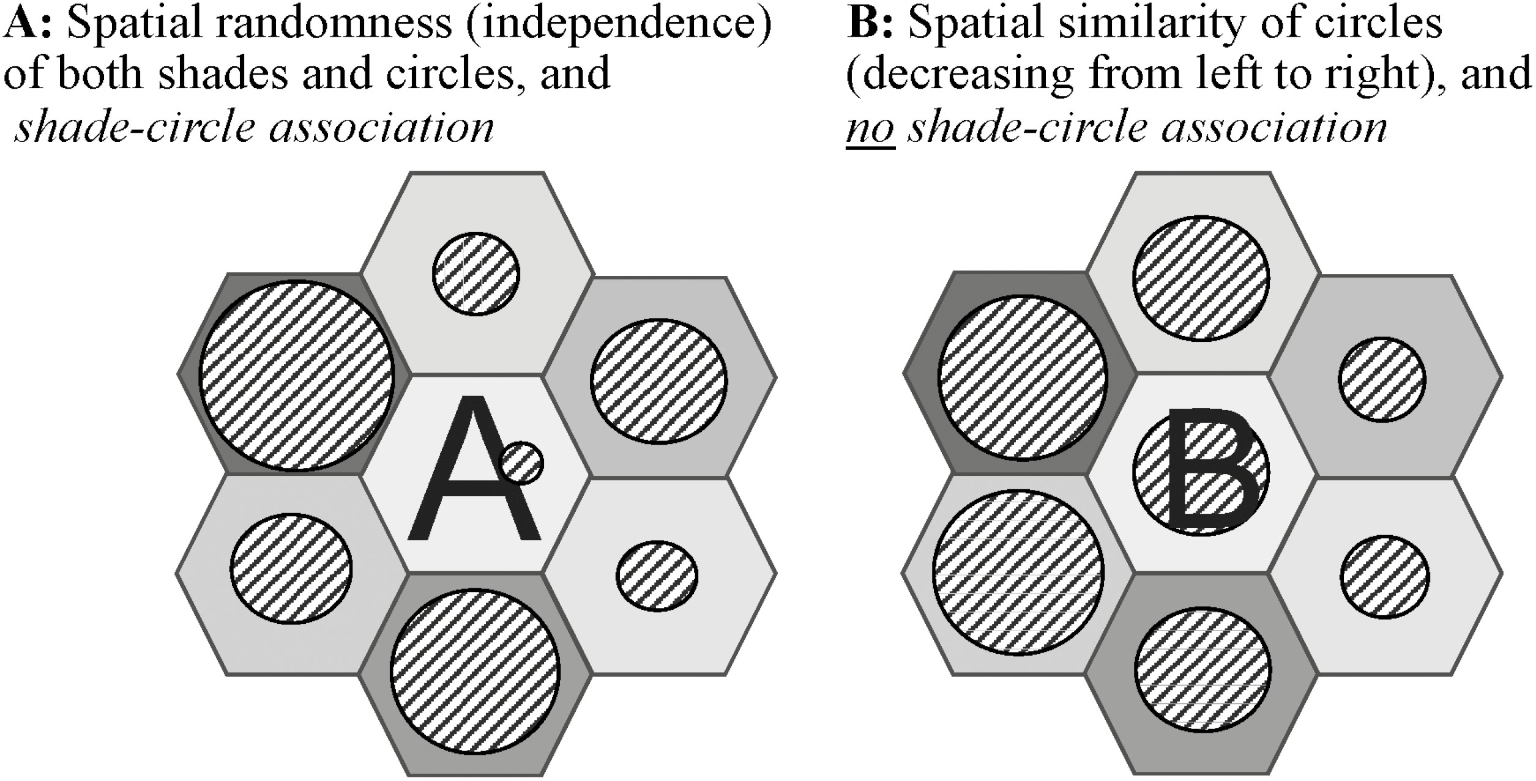
Why spatial analytics is needed
Spatial perspectives in family health research https://academic.oup.com/fampra/article/39/3/556/6463006
4

Slide 5
Intuition for minimum Moran’s I
Haggard, E. A. (1958). Intraclass correlation and the analysis of variance
“all the variation is within classes [neighbors of red squares], with the result that there is no variation between class (i.e., each class sum equals [the same #]).”
Notes:
Note that the value of the RED square itself matters too.

Slide 6
Intuition for Maximum Moran’s I
Haggard, E. A. (1958). Intraclass correlation and the analysis of variance
“there is no variation between the scores in any of the [classes [neighbors of red squares]; rather all the variation is between the [classes [the same #]).”
Notes:
Note that the value of the RED square itself matters too.

Slide 7
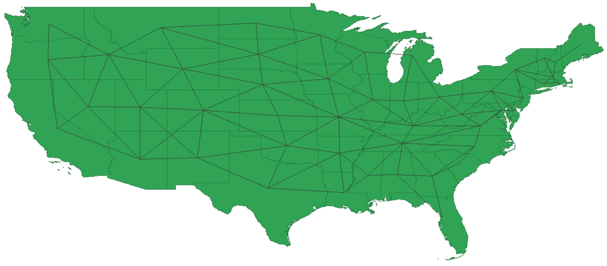
Networks spatial structure

Slide 8
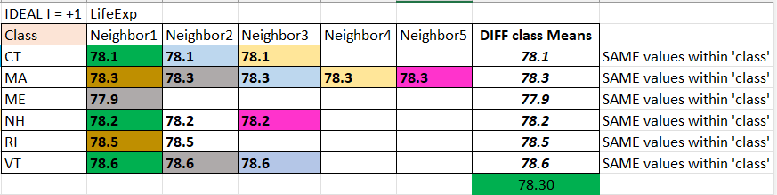
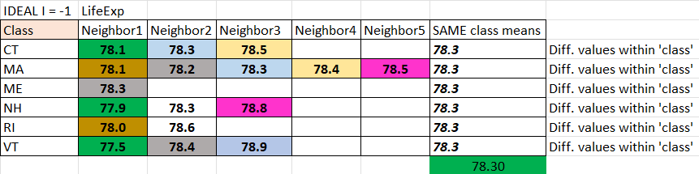
Maximum within-class (‘auto’) correlation, and minimum (-1)
“in Example A there is no variation between the scores in any of the rows[…[]; rather all the variation is between the row averages [sums] (i.e., between the classes), namely 77.9, 78.1, ... , 78.6. “
“In Example B all the variation is within the rows or classes, with the result that there is no variation between classes (i.e., each class average [sum] equals 78.3).’
Haggard, E. A. (1958). Intraclass correlation and the analysis of variance
https://drive.google.com/file/d/15sqL7oOhYtLar-iUScwg6r7PG0sB2l8_/view?usp=share_link
Notes:
Technically, numbers are NOT possible: same colors are SAME states! Spatial structure imposes ‘strictures’!

Slide 10
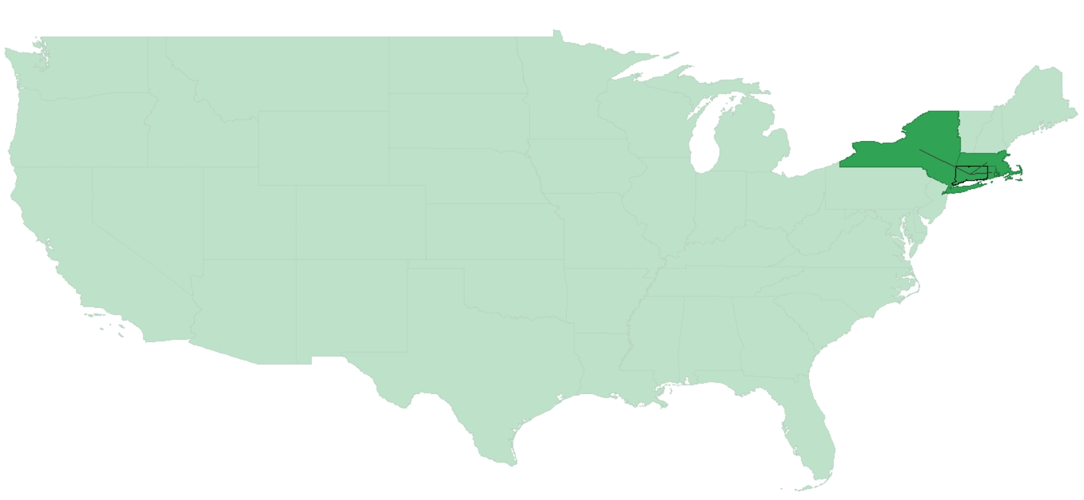
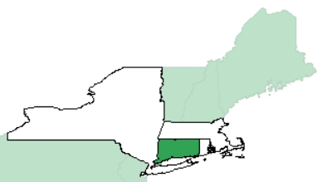
ME
NY
VT
NH
MA
CT
RI
Lines from the actual *.gal weights file in GeoDa for CT:
CT 3
NY MA RI

Slide 11
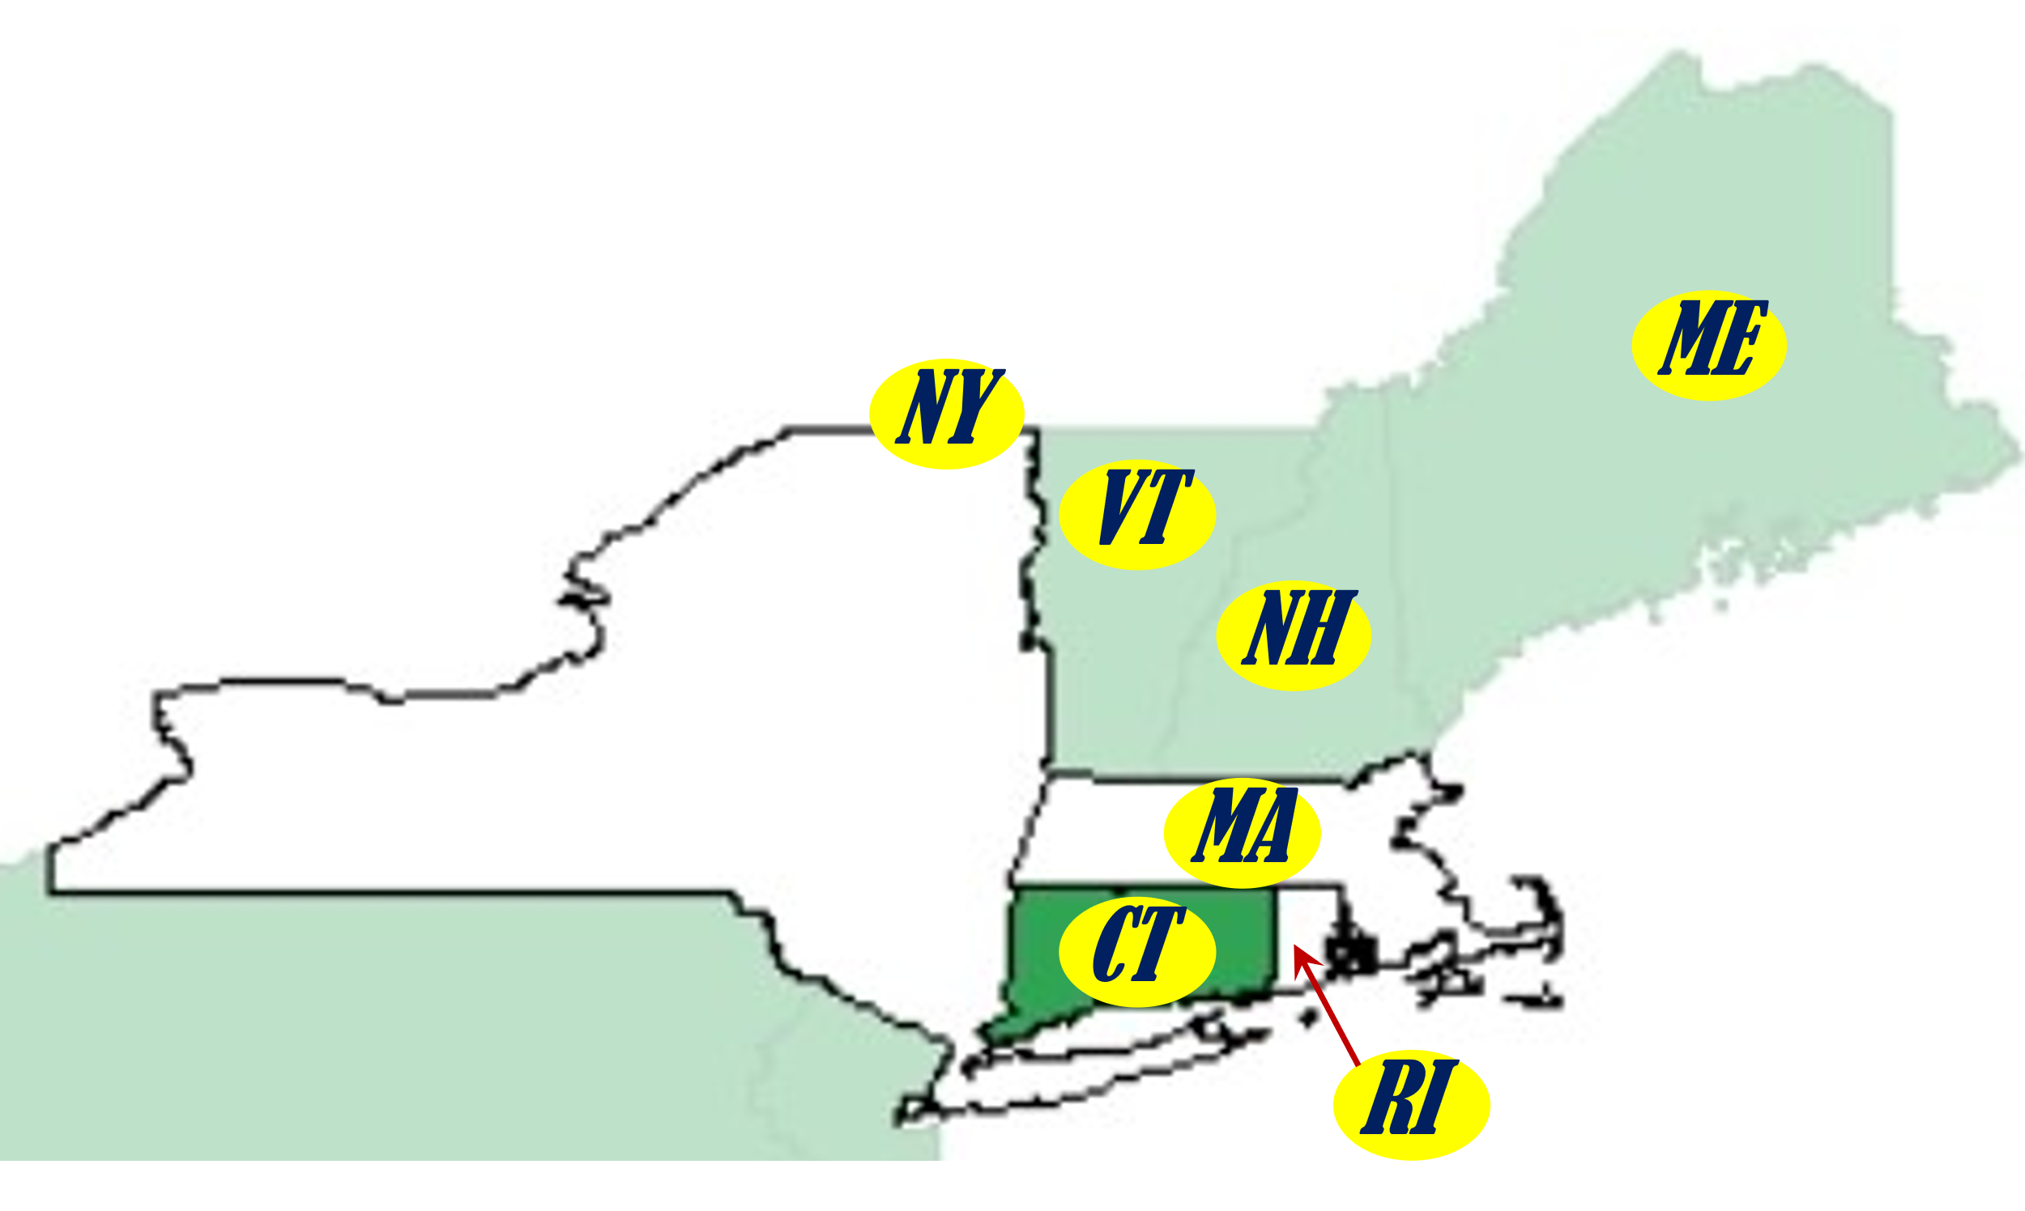
From naïve/a-spatial to spatial regression
A classic regression Y_{i} = α. + β.·X_{i} + ε_{i} would become for spatially connected/nonindependent data e.g.:
Y_{CT} = ρ·(1/3·Y_{MA} + 1/3·Y_{NY} + 1/3·Y_{RI}) + α. + β.·X_{CT} + ε_{CT},
which says that MA, NY, and RI are neighbors of CT
Y_{ME} = ρ·(1·Y_{NH}) + α. + β.·X_{ME} + ε_{ME},
which says that only NH is a US state neighbor of ME
Y_{MA} = ρ·(1/5·Y_{CT} + 1/5·Y_{NY} + 1/5·Y_{NH}+ 1/5·Y_{RI}+ 1/5·Y_{VT}) + α. + β.·X_{MA} + ε_{MA},
which says that CT, NY, NH, RI and VT and RI are neighbors of NY
Y_{RI} = ρ·(1/2·Y_{CT} + 1/2·Y_{MA}) + α. + β.·X_{RI} + ε_{RI},
which says that CT and MA are neighbors of RI
etc., 45 more times
Self & Other

Slide 12
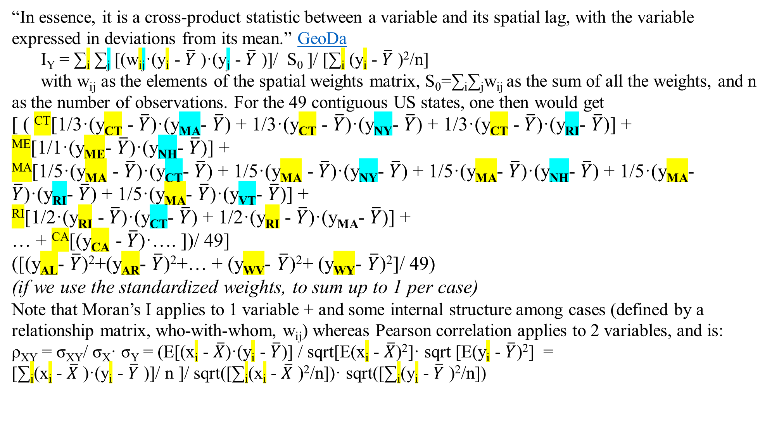
Spelling out the ‘auto’-correlation meanings
“In essence, it is a cross-product statistic between a variable and its spatial lag, with the variable expressed in deviations from its mean.” GeoDa
I_{Y} = ∑_{i} ∑_{j} [(w_{ij}·(y_{i} - $\overline{Y}$ )·(y_{j} - $\overline{Y}$ )]/ S₀ ]/ [∑_{i} (y_{i} - $\overline{Y}$ )²/n]
with w_{ij} as the elements of the spatial weights matrix, S₀=∑_{i}∑_{j}w_{ij} as the sum of all the weights, and n as the number of observations. For the 49 contiguous US states, one then would get
[ ( ^{CT}[1/3·(y_{CT} - $\overline{Y}$)·(y_{MA}- $\overline{Y}$) + 1/3·(y_{CT} - $\overline{Y}$)·(y_{NY}- $\overline{Y}$) + 1/3·(y_{CT} - $\overline{Y}$)·(y_{RI}- $\overline{Y}$)] +
^{ME}[1/1·(y_{ME}- $\overline{Y}$)·(y_{NH}- $\overline{Y}$)] +
^{MA}[1/5·(y_{MA} - $\overline{Y}$)·(y_{CT}- $\overline{Y}$) + 1/5·(y_{MA} - $\overline{Y}$)·(y_{NY}- $\overline{Y}$) + 1/5·(y_{MA}- $\overline{Y}$)·(y_{NH}- $\overline{Y}$) + 1/5·(y_{MA}- $\overline{Y}$)·(y_{RI}- $\overline{Y}$) + 1/5·(y_{MA}- $\overline{Y}$)·(y_{VT}- $\overline{Y}$)] +
^{RI}[1/2·(y_{RI} - $\overline{Y}$)·(y_{CT}- $\overline{Y}$) + 1/2·(y_{RI} - $\overline{Y}$)·(y_{MA}- $\overline{Y}$)] +
… + ^{CA}[(y_{CA} - $\overline{Y}$)·…. ])/ 49]
([(y_{AL}- $\overline{Y}$)²+(y_{AR}- $\overline{Y}$)²+… + (y_{WV}- $\overline{Y}$)²+ (y_{WY}- $\overline{Y}$)²]/ 49)
(if we use the standardized weights, to sum up to 1 per case)
Note that Moran’s I applies to 1 variable + and some internal structure among cases (defined by a relationship matrix, who-with-whom, w_{ij}) whereas Pearson correlation applies to 2 variables, and is:
ρ_{XY} = σ_{XY}/ σ_{X}· σ_{Y} = (E[(x_{i} - $\overline{X}$)·(y_{i} - $\overline{Y}$)] / sqrt[E(x_{i} - $\overline{X}$)²]· sqrt [E(y_{i} - $\overline{Y}$)²] =
[∑_{i}(x_{i} - $\overline{X}$ )·(y_{i} - $\overline{Y}$ )]/ n ]/ sqrt([∑_{i}(x_{i} - $\overline{X}$ )²/n])· sqrt([∑_{i}(y_{i} - $\overline{Y}$ )²/n])

Slide 13
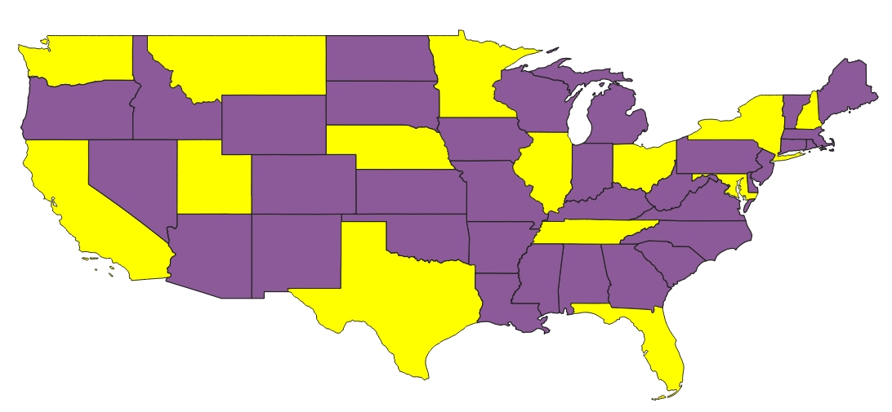
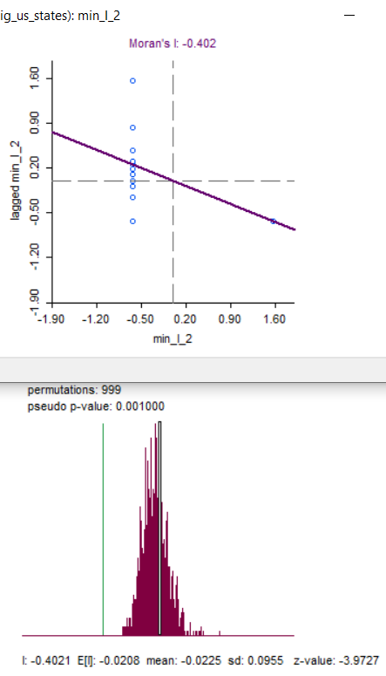
min I possible 2: I = -0.402
By-hand method: started to the NW corner, and walked down and right, to ensure YELLOW states are surrounded by PURPLE ones

Slide 14
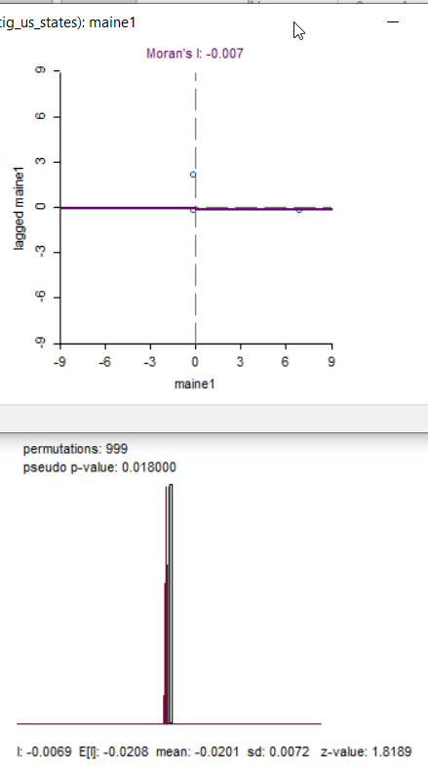
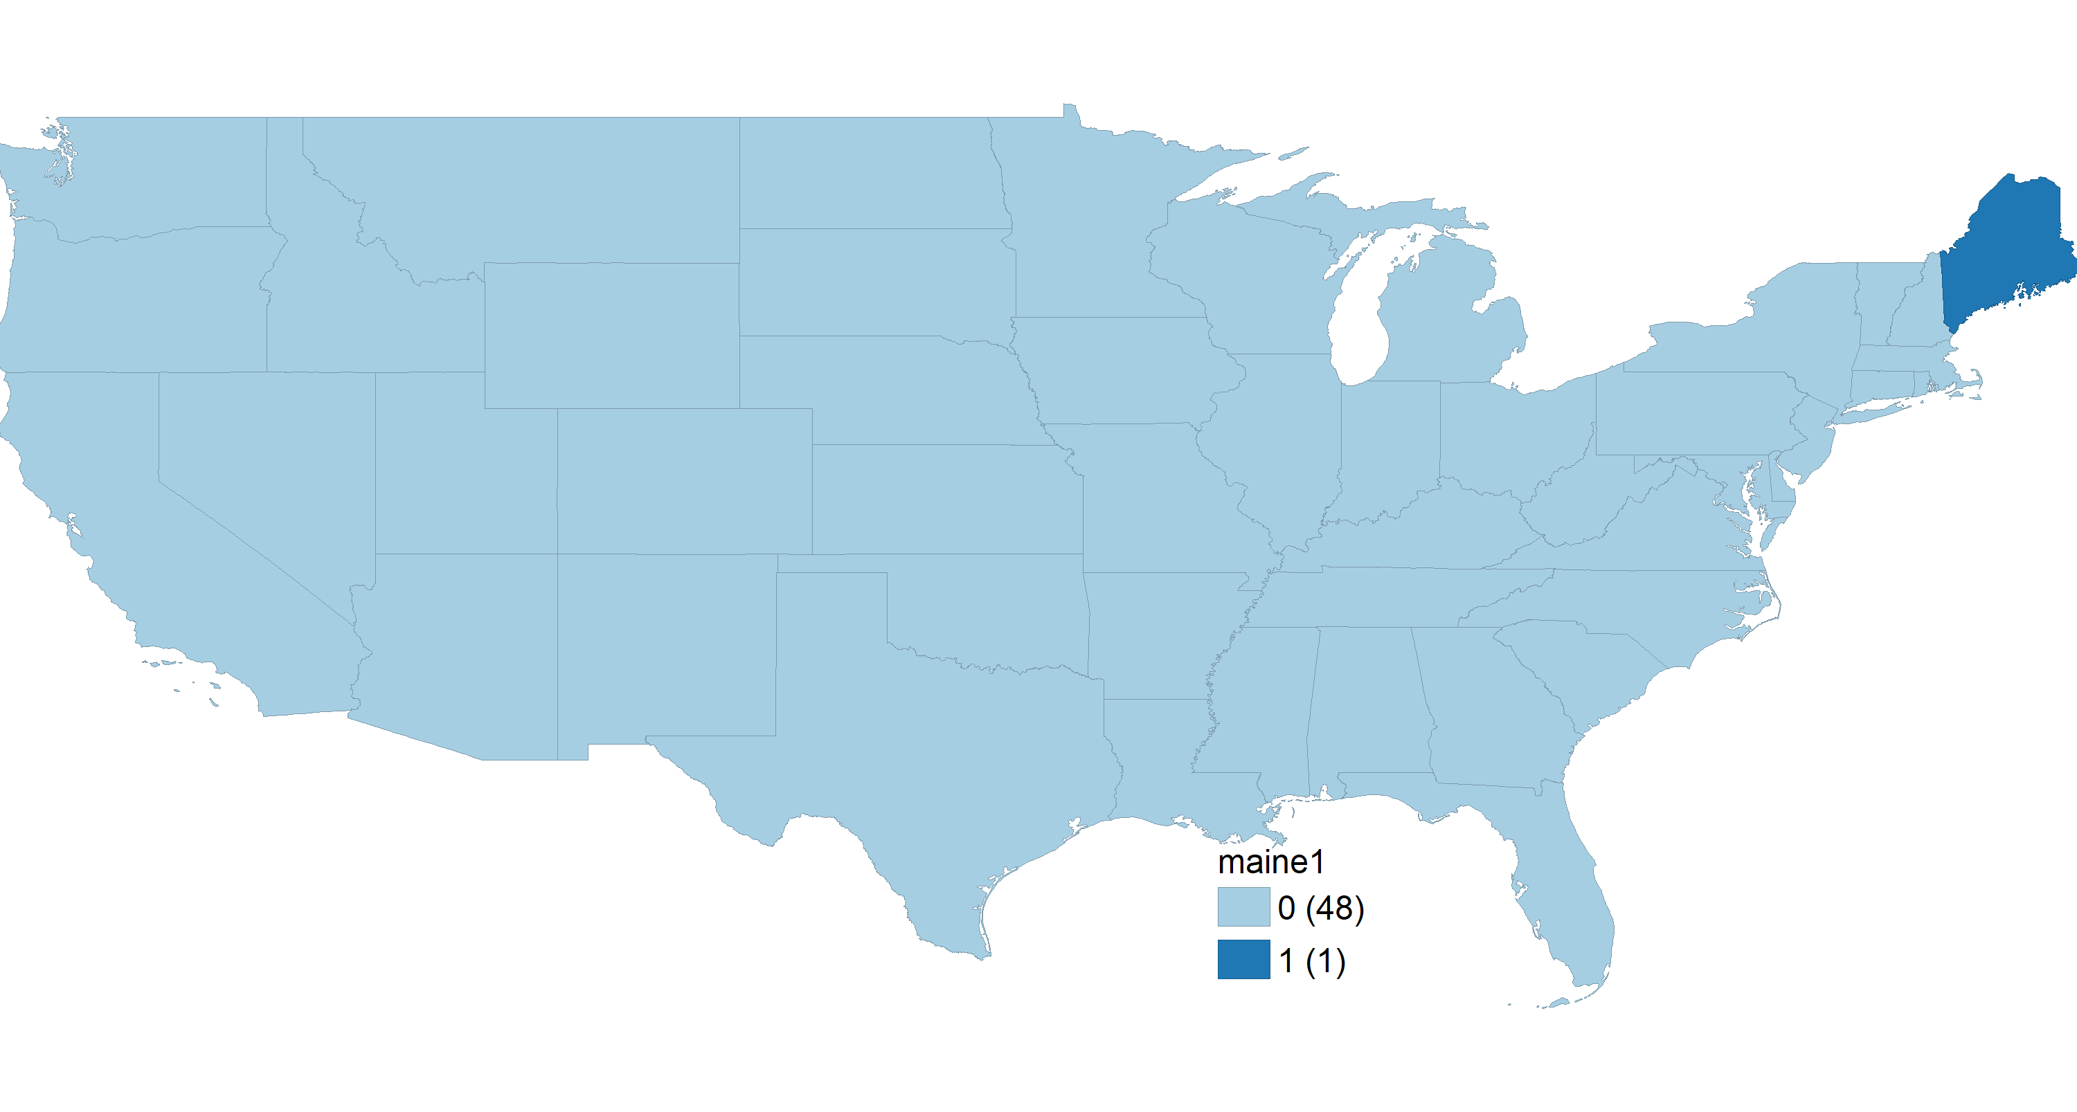
Small’s possible patterns - 2
I = -.007, z = 1.819, p = .018

Slide 15
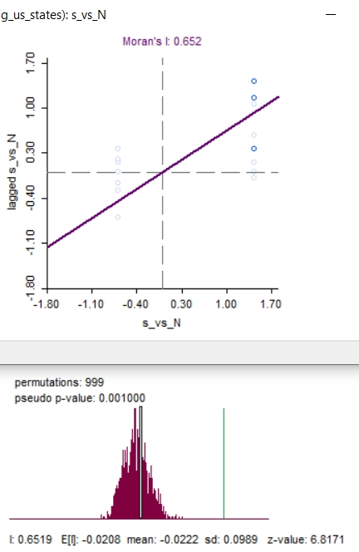
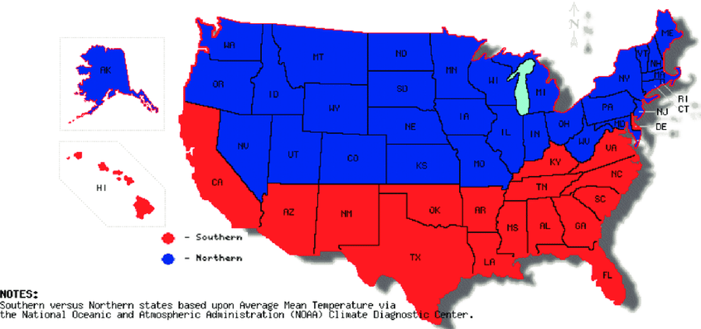
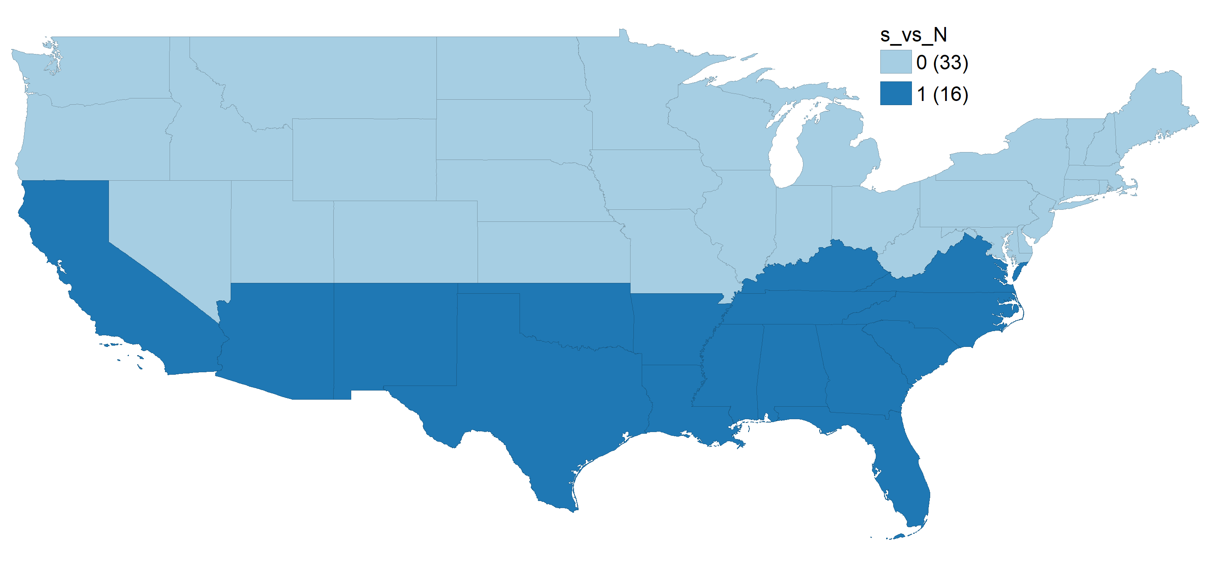
Large I’s possible patterns
I = +.652, z = 6.82, p < .001

Slide 16
+.38^{.002}
-.07^{.169}_{I.%M}
Income._{s}
+.35^{.001}_{I.LEx}
+.38^{.002}_{LEx.I}
-.02^{.368}_{%M.I}
+.43^{.001}
%Minority._{s}
+.54^{.001}
-.27^{. 001}_{LEx.%M}
LifeExp._{s}
-.18^{.006}_{%M.LEx}
Univariate and bivariate Moran’s Is (##_{2nd .1st})
https://geodacenter.github.io/workbook/5a_global_auto/lab5a.html ; #of neighbors Moran’s Is .245, pseudo p = .007
16
Notes:
“bivariate spatial correlation measures the degree to which the value for a given variable at a location is correlated with its neighbors for a different variable.” “In fact, the notion of spatial correlation pertains to the effect of neighbors on a central location, not the other way around. While the Moran scatter plot seems to reverse this logic, this is purely a formalism, without any consequences in the univariate case. ”

Slide 17
. pcorr lfex20stcdc pminrty15_19st inck1519st (obs=49)
Partial and semipartial correlations of lfex20stcdc with
Partial Semipartial Partial Semipartial Significance
Variable | corr. corr. corr.^2 corr.^2 value
------------+-----------------------------------------------------------------
pminrty15~t | -0.4185 -0.3030 0.1751 0.0918 0.0031
inck1519st | 0.7475 0.7400 0.5587 0.5475 0.0000
Partial and semipartial correlations of pminrty15_19st with
Partial Semipartial Partial Semipartial Significance
Variable | corr. corr. corr.^2 corr.^2 value
------------+-----------------------------------------------------------------
inck1519st | 0.4475 0.4430 0.2003 0.1963 0.0014
lfex20stcdc | -0.4185 -0.4079 0.1751 0.1664 0.0031
Partial and semipartial correlations of inck1519st with
Partial Semipartial Partial Semipartial Significance
Variable | corr. corr. corr.^2 corr.^2 value
------------+-----------------------------------------------------------------
pminrty15~t | 0.4475 0.3241 0.2003 0.1050 0.0014
lfex20stcdc | 0.7475 0.7286 0.5587 0.5308 0.0000

Slide 18
Income._{s}
Income._{s}
+.32*_{I.%M}
+.45*
+.75*
+.73*_{I.LEx}
%Minority._{s}
LifeExp._{s}
+.44*_{%M.I}
+.74*_{LEx.I}
-.42*
%Minority._{s}
-.30*_{LEx.%M}
LifeExp._{s}
-.41*_{%M.LEx}
Sample naïve = a-spatial PARTIAL correlations (3rd variable is the 3rd)
NON-Directional!
Sample naïve = a-spatial SEMI-PARTIAL correlations
Directional
(##_{Outcome.Predictor})
* The partial correlation between y and x1 is an attempt to estimate the correlation that would be observed between y and x1 if the other x's did not vary.
* The semipartial correlation, also called part correlation, between y and x1 is an attempt to estimate the correlation that would be observed between y and x1 after the effects of all other x's are removed from x1 but not from y.
18

Slide 19
Partial and semipartial correlations of lfex20stcdc with
Partial Semipartial Partial Semipartial Significance
Variable | corr. corr. corr.^2 corr.^2 value
------------+-----------------------------------------------------------------
pminrty15~t | 0.0739 0.0525 0.0055 0.0028 0.6176
lglfex20 | 0.6988 0.6917 0.4883 0.4785 0.0000
Partial and semipartial correlations of lfex20stcdc with
Partial Semipartial Partial Semipartial Significance
Variable | corr. corr. corr.^2 corr.^2 value
------------+-----------------------------------------------------------------
inck1519st | 0.5536 0.3931 0.3064 0.1545 0.0000
lglfex20 | 0.5770 0.4178 0.3330 0.1746 0.0000
Partial and semipartial correlations of pminrty15_19st with
Partial Semipartial Partial Semipartial Significance
Variable | corr. corr. corr.^2 corr.^2 value
------------+-----------------------------------------------------------------
inck1519st | 0.3511 0.2512 0.1233 0.0631 0.0144
lgpmin1519 | 0.7262 0.7079 0.5274 0.5011 0.0000
Partial and semipartial correlations of pminrty15_19st with
Partial Semipartial Partial Semipartial Significance
Variable | corr. corr. corr.^2 corr.^2 value
------------+-----------------------------------------------------------------
lfex20stcdc | 0.0877 0.0627 0.0077 0.0039 0.5535
lgpmin1519 | 0.6939 0.6869 0.4814 0.4718 0.0000
Partial and semipartial correlations of inck1519st with
Partial Semipartial Partial Semipartial Significance
Variable | corr. corr. corr.^2 corr.^2 value
------------+-----------------------------------------------------------------
pminrty15~t | 0.3305 0.2789 0.1092 0.0778 0.0218
lginck19st | 0.5764 0.5618 0.3322 0.3156 0.0000
Partial and semipartial correlations of inck1519st with
Partial Semipartial Partial Semipartial Significance
Variable | corr. corr. corr.^2 corr.^2 value
------------+-----------------------------------------------------------------
lfex20stcdc | 0.5798 0.4894 0.3362 0.2395 0.0000
lginck19st | 0.3133 0.2269 0.0982 0.0515 0.0301
[COMPARE SAME COLORS]

Slide 20
Income._{s}
Income._{s}
+.32_{I<-%M}
+.45*
+.75*
+.73_{I<-LEx}
+.44_{%M<-I}
+.74_{LEx<-I}
%Minority._{s}
LifeExp._{s}
-.42*
%Minority._{s}
-.30_{LEx<-%M}
LifeExp._{s}
-.41_{%M<-LEx}
Sample naïve = a-spatial PARTIAL correlations
NON-Directional!
Sample naïve = a-spatial PARTIAL correlations
Directional (3rd variable is the ‘other’)
* The partial correlation between y and x1 is an attempt to estimate the correlation that would be observed between y and x1 if the other x's did not vary.
* The semipartial correlation, also called part correlation, between y and x1 is an attempt to estimate the correlation that would be observed between y and x1 after the effects of all other x's are removed from x1 but not from y.
(##_{Outcome<-Predictor})
20

Slide 21
sLAG Inc_{s}
*
Income._{s}
Income._{s}
+.32_{I<-%M}
+.28_{I<-%M}
+.49_{I<-LEx}
+.73_{I<-LEx}
+.44_{%M<-I}
+.74_{LEx<-I}
+.25_{%M<-I}
+.39_{LEx<-I}
%Minority._{s}
-.30_{LEx<-%M}
%Minority._{s}
+.05_{LEx<-%M}
LifeExp._{s}
LifeExp._{s}
-.41_{%M<-LEx}
+.06_{%M<-LEx}
*
*
Sample naïve = a-spatial SEMI-PARTIAL correlations
Directional
(3rd variable is the 3rd)
sLAG Inc_{s}
sLAG Inc_{s}
Spatial SEMI-PARTIAL correlations – Directional
(3rd variable is the ‘DV lag’)
* The partial correlation between y and x1 is an attempt to estimate the correlation that would be observed between y and x1 if the other x's did not vary (bidirectional)
* The semipartial correlation, also called part correlation, between y and x1 is an attempt to estimate the correlation that would be observed between y and x1 after the effects of all other x's are removed from x1 but not from y (directional)
21

Slide 22
Naïve/a-spatial ‘causal’ mediation model
(p values in superscripts)
sLAG Income_{s}
*
Income_{s}
i_{T} =-.023^{.252}
TE = i_{T} + d_{P} = d_{T} + i_{P}
INT_{Med} = i_{T} - i_{P} = d_{T} – d_{P}
Direct Pure = d_{P}
Direct Total = d_{T}
Indirect Pure = i_{P}
Indirect Total = i_{T}
+.154^{.109}
+.160^{.001}
-.312^{.001}
%Minority_{s}
LifeExp._{s}
d_{P}=-.037^{.001}
Total (spatial) effect
TE = -.061^{.892}
Mediated Interaction (spatial) effect
INT_{Med} = -.001^{.152}
Hence i_{T} = i_{P} = i_{BK} & d_{T} = d_{P}
Controlled Direct Effect = -.037^{.001}
ContrDE = cPrime + ReferenceInteraction *Interaction*MIntercept
*
sLAG Debt_{s}.
Standardized coefficients from
X + M + X*M + -> Y
X + -> M

Slide 23
Mplus ‘causal’ mediation ‘by hand’ + VanderWeele
USEVARIABLES ARE
CovY1 CovM1 M Y X XbyM ;! CovM1 can add; all new variables, not in data, but are defined below
define: ! we define X, M, Y here so anyone can replace only this upfront define section
X = YOUR_X - XMean ;
MODEL:
Y on X (cPrime) !cPrime, the original mediation a-b-c-c' labeling
M (b) !b, the original mediation a-b-c-c' labeling
XbyM (Interact) !each label HAS to be entered in separate rows for each predictor
CovY1 ; !lagXbyM
M on X (a)
CovM1; !a, the original mediation a-b-c-c' labeling
!can add COVARIATES specific to M: CovM1 ;
[M] (mInt); !define M intercept for use below in ContrDE & INTref
MODEL CONSTRAINT: ! Additional effects from VanderWeele NEW (DirPure IndTot TotEff IndPure DirTot INTmed ContrDE INTref PrAttrIn PrElim );
!INTref & ContrDE are NOT fixed parameters, but varying with mInt=Mediator intercept
DirTot = cPrime + Interact*mInt + Interact*a; ! TOTAL DIRECT EFFECT as in 3. M&A
DirPure = cPrime + Interact*mInt; ! PURE DIRECT EFFECT as in 3. M&A
!dp = ContrDE + INTref; !as in 2. VanderWeele: alternative estimation
IndTot = a*b + Interact*a; ! TOTAL INDIRECT EFFECT as in 3. M&A
IndPure = a*b ; ! PURE INDIRECT EFFECT = B&K effect as in 0. Baron & Kenny
TotEff = IndTot+DirPure; !TOTAL EFFECT
INTmed = TotEff - IndPure - DirPure; ! MEDIATED INTERACTION as in 2. VanderWeele / ContrDE = cPrime + INTref*Interact*mInt; ! CONTROLLED DIRECT EFFECT as in 2. VanderWeele /added EC FT JF/
!ContrDE = dp - INTref; ! CONTROLLED DIRECT EFFECT as in 2. VanderWeele: alternative estimation; is estimated at a particular M value, here at the M intercept
!one can replace its intercept m0 used here with specific M values of interest;
INTref = DirPure - ContrDE ; ! REFERENCE INTERACTION as in 2. VanderWeele /added EC FT JF/
PrAttrIn = TotEff - IndPure - ContrDE ;! Proportion Attributable to Interaction as in 2. VanderWeele /added EC FT JF/
PrElim = IndPure + INTmed + INTref ; ! Portion Eliminated as in 2. VanderWeele
! PrElim = TE - ContrDE ; !as in 2. VanderWeele: alternative estimation /added EC FT JF/
OUTPUT: SAMP TECH1 TECH4 standardized CINTERVAL
Coman, E. N., Thoemmes, F., & Fifield, J. (2017). Commentary: Causal Effects in Mediation Modeling: An Introduction with Applications to Latent Variables. Frontiers in Psychology, 8(151). https://www.frontiersin.org/articles/10.3389/fpsyg.2017.00151/full

Slide 24
Spatial ‘causal’ mediation model
(p values in superscripts)
sLAG Income_{s}
*
Income_{s}
i_{T} =-.028^{.152}
TE = i_{T} + d_{P} = d_{T} + i_{P}
INT_{Med} = i_{T} - i_{P} = d_{T} – d_{P}
Direct Pure = d_{P}
Direct Total = d_{T}
Indirect Pure = i_{P}
Indirect Total = i_{T}
-.317^{.001}
+.160^{.001}
-.312^{.001}
%Minority_{s}
LifeExp._{s}
d_{P}=-.019^{.950}
Total (spatial) effect
TE = -.047^{.878}
i_{P} = +.023^{.023}
Mediated Interaction (spatial) effect
INT_{Med} = +.051^{.058}
Hence i_{T} > i_{P} = i_{BK} & d_{T} > d_{P}
Controlled Direct Effect = -.019^{.082}
ContrDE = cPrime + ReferenceInteraction *Interaction*MIntercept
*
sLAG Debt_{s}.
Standardized coefficients from
X + M + X*M + Y_{Sp.Lag} -> Y
X + M_{Sp.Lag} -> M

Slide 25
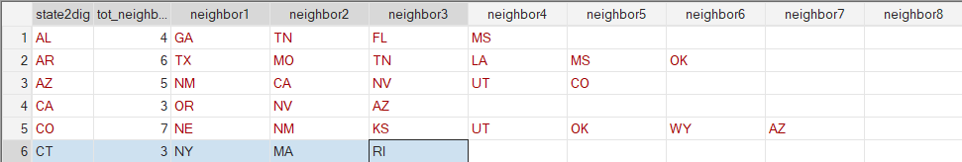
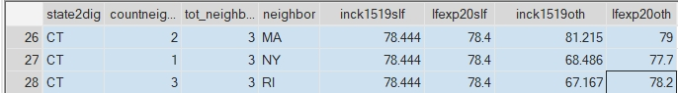
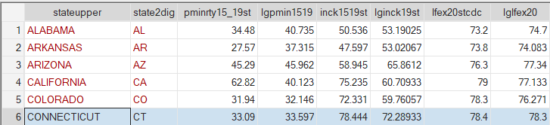

Wide = Horizontal
Long = Vertical
Wide Dyadic = Horizontal Dyadic
Long Dyadic = Vertical Dyadic
25

Slide 26
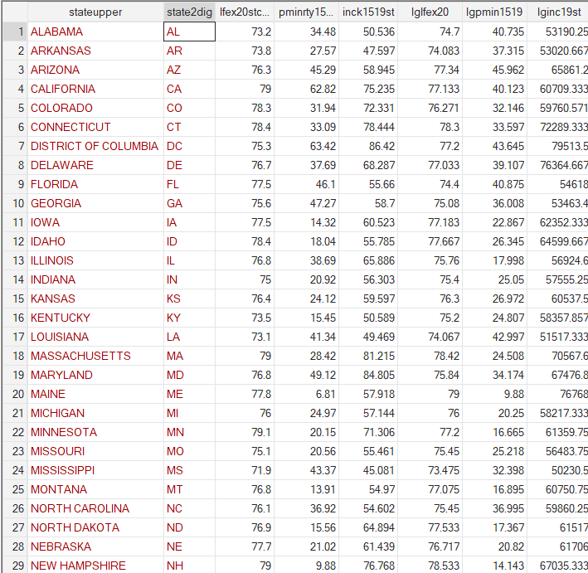

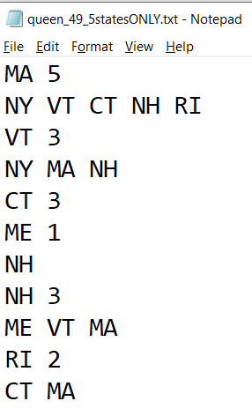
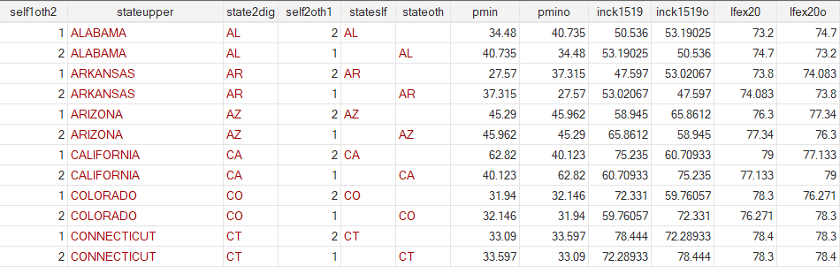
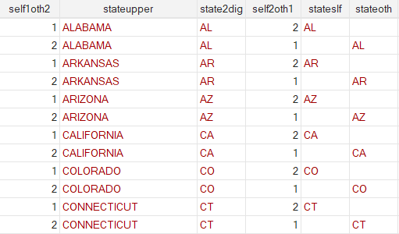
Gonzalez Griffin approach expanded to dyadic
Merge them
Turn the data from n=49 to self+others -> Moran’s I becomes a Pearson correlation in the N = 98 data.
+++

Slide 27
* 1. Overall within-partner XY correlation rxy.c = rx'y'.c
. pcorr pmin lfex20 self1oth2(obs=98)Partial and semipartial correlations of pmin with
Partial Semipartial Partial Semipartial Significance
Variable | corr. corr. corr.^2 corr.^2 value
------------+-----------------------------------------------------------------
lfex20 | -0.2127 -0.2126 0.0453 0.0452 0.0364
self1oth2 | -0.0309 -0.0302 0.0010 0.0009 0.7639
. * 2. X pairwise intraclass correlation rxx'.c
. pcorr pmin pmino self1oth2(obs=98)Partial and semipartial correlations of pmin with
Partial Semipartial Partial Semipartial Significance
Variable | corr. corr. corr.^2 corr.^2 value
------------+-----------------------------------------------------------------
pmino | 0.6216 0.6214 0.3864 0.3861 0.0000
self1oth2 | -0.0623 -0.0489 0.0039 0.0024 0.5444
. * 3. Y pairwise intraclass correlation ryy'.c
. pcorr lfexp lfex20o self1oth2(obs=98)Partial and semipartial correlations of lfexp with
Partial Semipartial Partial Semipartial Significance
Variable | corr. corr. corr.^2 corr.^2 value
------------+-----------------------------------------------------------------
lfex20o | 0.6809 0.6809 0.4636 0.4636 0.0000
self1oth2 | -0.0003 -0.0002 0.0000 0.0000 0.9975
. * 4. XY cross-intraclass correlation rxy’.c = rx'y.c
. pcorr pmin lfex20o self1oth2(obs=98)Partial and semipartial correlations of pmin with
Partial Semipartial Partial Semipartial Significance
Variable | corr. corr. corr.^2 corr.^2 value
------------+-----------------------------------------------------------------
lfex20o | -0.2611 -0.2610 0.0682 0.0681 0.0098
self1oth2 | -0.0312 -0.0301 0.0010 0.0009 0.7616

Slide 28
Gonzalez & Griffin correlation decomposition
Overall within-partner
XY correlation
Figure 9.1 Figure 9.1 All possible pairwise correlations between variables X, Y, and their corresponding "reverse codes".
XY cross-intraclass correlation
Note that in this framework r_{xy'} = r_{x'y} and
r_{xy} = r_{x'y'}
X pairwise
intraclass
correlation
Y pairwise
intraclass
correlation
Gonzalez, R., & Griffin, D. (2000). On the statistics of interdependence: Treating dyadic data with respect https://drive.google.com/file/d/1z3I7NjKL7RKAhKNhsOfTAvajLkPuESsh/view?usp=share_link In W. Ickes & S. Duck (Eds.),
The Social Psychology of Personal Relationships (pp. 271-301).
28

Slide 29
Gonzalez & Griffin - distinguishable case
Overall within-partner
XY correlation
Figure 9.2 All possible pairwise correlations between X, Y, and their corresponding "reverse codes" in the distinguishable case. Variable C has been partialled out from all correlations.
[partial correlations; C is 1 for ‘self’ and 2 for ‘other’]
XY cross-intraclass correlation
X pairwise
intraclass
correlation
Y pairwise
intraclass
correlation
Gonzalez, R., & Griffin, D. (2000). On the statistics of interdependence: Treating dyadic data with respect https://drive.google.com/file/d/1z3I7NjKL7RKAhKNhsOfTAvajLkPuESsh/view?usp=share_link In W. Ickes & S. Duck (Eds.),
The Social Psychology of Personal Relationships (pp. 271-301).
29

Slide 30
Gonzalez & Griffin semipartial correlations
r_{xy.c}
‘SELF’
%Minority_{s}
‘‘SELF’
LifeExp._{s}
+.21^{.036}
Overall province-neighbors
XY correlation
r_{xx’.c}
r_{xy'.c}
r_{yy’.c}
Y pairwise
intraclass
correlation
XY cross-intraclass correlation
X pairwise
intraclass
correlation
+.62^{.001}
-.26^{.010}
+.68^{.001}
r_{x'y’.c}
‘Others’= Neighbors’ Average
%Minority_{s}
Spatial Lag
‘Others’= Neighbors’ Average
LifeExp._{s}
Spatial Lag
@ +.21^{.036}
Overall province-neighbors
XY correlation
p values are irrelevant: the N = 49 is the population of provinces, there are no other contiguous US States out there!
r_{xy'.c} = r_{x’y.c} by data design: confirmed
30
Notes:
xx’ yy’ are like Moran’s I’s
P values need On the Statistics of Interdependence: Treating Dyadic Data with Respect + Richard Gonzalez Dale Griffin

Slide 31
sLAG Inc_{s}
*
Income._{s}
Income._{s}
+.33*_{I<-%M}
+.45
+.75
+.58*_{I<-LEx}
+.35*_{%M<-I}
+.55*_{LEx<-I}
%Minority_{s}
LifeExp._{s}
-.42
%Minority_{s}
+.07_{LEx<-%M}
LifeExp._{s}
+.09_{%M<-LEx}
*
*
sLAG Inc_{s}
sLAG Inc_{s}
Sample naïve = a-spatial PARTIAL correlations
NON-Directional!
Spatial PARTIAL correlations - Directional
(2nd predictor is the ‘DV spatial lag’)
* The partial correlation between y and x1 is an attempt to estimate the correlation that would be observed between y and x1 if the other x's did not vary (bidirectional) – adding the lag of the outcome makes it kind of directional.
* The semipartial correlation, also called part correlation, between y and x1 is an attempt to estimate the correlation that would be observed between y and x1 after the effects of all other x's are removed from x1 but not from y (directional)
31

Slide 32
+.54*
+.38*
Income._{s}
Income._{s}
+.12^{NS}
+.79*
+.29
+.71
+.43*
+.54*
+.70*
%Minority._{s}
+.70*
%Minority._{s}
LifeExp._{s}
LifeExp._{s}
-.11
-.06^{NS}
Moran’s Is &
‘Spatial’ correlations
Model implied Correlation from Nonrecursive with IVs
‘Self-’Other’ intraclass correlations r_{xx’} &
Partial pairwise correlations r_{xx’.c}
Correlations between all pairs of residuals were NS, so were all set @0
Spatial perspectives in family health research
Kenny chapter
32

Slide 33
Income._{s}
Income._{s}
+.12^{.231}
+.22
+.69
+.72^{.001}
%Minority._{s}
LifeExp._{s}
%Minority._{s}
LifeExp._{s}
-.14
-.21^{.036}
Standardized semi-partial correlations:
from 3 bivariate pairwise models to separate out within-partner from cross-intraclass
correlations in the distinguishable ‘dyadic’ case
= Overall within-partner XY correlation r_{xy.c} = r_{x'y'.c}
‘Spatial’ correlations
Model implied Correlation from Nonrecursive with IVs
Spatial perspectives in family health research
Kenny chapter
33
Notes:
sem (lfex20stcdc <- inck1519st lglfex20 ) (inck1519st <- lfex20stcdc lginck19st) , cov(e.inck1519st*e.lfex20stcdc) //, standardized
estat framework , fitted standardized // implied correlations
sem (lfex20stcdc <- pminrty15_19st lglfex20 ) (pminrty15_19st <- lfex20stcdc lgpmin1519) , cov(e.pminrty15_19st*e.lfex20stcdc)
sem (pminrty15_19st <- inck1519st lgpmin1519 ) (inck1519st <- pminrty15_19st lginck19st) , cov(e.inck1519st*e.pmi

Slide 34
Income._{s}
Income._{s}
-.??.???
+.22^{.123}
+.69^{<.001}
-.??.???
%Minority._{s}
LifeExp._{s}
%Minority._{s}
LifeExp._{s}
-.14^{.333}
-.??.???
Standardized semi-partial correlations:
from 3 bivariate pairwise models to separate out within-partner from cross-intraclass
correlations in the distinguishable ‘dyadic’ case
Sample naïve = a-spatial correlations
Correlations between all pairs of residuals were NS, so were all set @0
Spatial perspectives in family health research
Kenny chapter
34

Slide 35
Actor Partner model (G&G)
‘SELF’
%Minority_{s}
‘‘SELF’
LifeExp._{s}
-.08^{.506}
-.21^{.091}
‘Others’= Neighbors’ Average
%Minority_{s}
Spatial Lag
“An actor effect, which represents the extent to which a dyad member's (the "actor") standing on variable X determines that actor's standing on variable Y, and a partner effect, which represents the extent to which the partner's standing on X determines the actor's standing on Y.” “Following the structural model illustrated in Figure 9.5 leads to the interpretation of the (semi-partial) pairwise rxy as the "actor correlation“ and the (semi-partial) pairwise rxy' as the "partner correlation".
Gonzalez, R., & Griffin, D. (2000). On the statistics of interdependence: Treating dyadic data with respect https://drive.google.com/file/d/1z3I7NjKL7RKAhKNhsOfTAvajLkPuESsh/view?usp=share_link In W. Ickes & S. Duck (Eds.),
The Social Psychology of Personal Relationships (pp. 271-301).
35

Slide 36
Interference and causal issues
“The principles of covariate control in the presence of interference are straightforward: like in the case of no interference, they follow from the fact that all backdoor paths from treatment to outcome must be blocked by a measured set of covariates.
However, without taking the time to draw the operative causal DAG with interference it is easy to make mistakes, like controlling only for individual-level covariates when block-level covariates are necessary to identify the causal effect of interest.” [1]:565
“If the individuals in the block share no common causes of A or Y , as in the DAG in Figure 4, then Ci suffices to block the backdoor paths from Ai to Yi
and from Aj to Yi and, therefore, exchangeability for the effect of A on Yi holds conditional on Ci.
That is, Yi(ai, aj ) ∐ A |Ci for all i.” [1]:565 [subscripts upgraded for clarity]
FIG. 4.
1. Ogburn, E. L., & VanderWeele, T. J. (2014). Causal Diagrams for Interference. Statistical Science, 29(4), 559-578.
Notes:
If the individuals in the block share no common
causes of A or Y , as in the DAG in Figure 4, then
Ci suffices to block the backdoor paths from Ai to Yi
and from Aj to Yi and, therefore, exchangeability for
the effect of A on Yi holds conditional on Ci.

Slide 37
Interference and causal issues
“If Cj is a direct cause of Yi for i = j , as in Figure 5(a), then exchangeability for the effect of A on Yi necessitates block- and not just individual-level covariates.
Even if each individual’s treatment is randomized conditional on his own covariates (this corresponds to the absence of arrows Cj to Ai for i = j on the DAG), there is still a backdoor path from Aj to Yi via Cj and, somewhat counterintuitively, it is necessary to control for Cj in addition to Ci in any model for the effect of A on Yi.
On the other hand, if Cj directly affects Ai but not Yi for i = j , as in Figure 5(b), then for exchangeability for the effect of A on Yi it suffices to condition only on Ci .” [1]:565
[subscripts upgraded for clarity]
FIG. 5.a.
FIG. 5.b.
1. Ogburn, E. L., & VanderWeele, T. J. (2014). Causal Diagrams for Interference. Statistical Science, 29(4), 559-578.

Slide 38
Spatial interference: interference by contagion?
Direct interference
“if individual i receives treatment and individual j does
not, individual j may be nevertheless be exposed to the
treatment of individual i”
Interference by contagion
Via the first individual’s outcome - It does not represent a direct causal pathway from the exposed individual to another individual’s outcome, but rather a pathway mediated by the outcome of the exposed individual.
Allocational interference
Treatment in this setting allocates individuals to groups; through interactions within a group individuals’ characteristics may affect one another.
“An example that often arises in the social science literature is the allocation of children to schools or of children to classrooms within schools”
[1]:565
X_{i}
Y_{i}
effect
X_{neighbors(i)}
Y_{neighbors(i)}
?
1. Ogburn, E. L., & VanderWeele, T. J. (2014). Causal Diagrams for Interference. Statistical Science, 29(4), 559-578.

Slide 39
Gonzalez & Griffin extensions possible
Figure 9.3 A latent variable model separating individual-level (unique) and dyad-level (shared) effects
Gonzalez, R., & Griffin, D. (2000). On the statistics of interdependence: Treating dyadic data with respect https://drive.google.com/file/d/1z3I7NjKL7RKAhKNhsOfTAvajLkPuESsh/view?usp=share_link In W. Ickes & S. Duck (Eds.),
The Social Psychology of Personal Relationships (pp. 271-301).
39

Slide 40
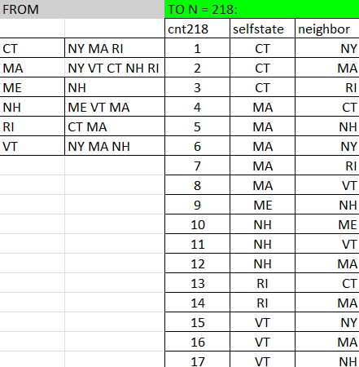
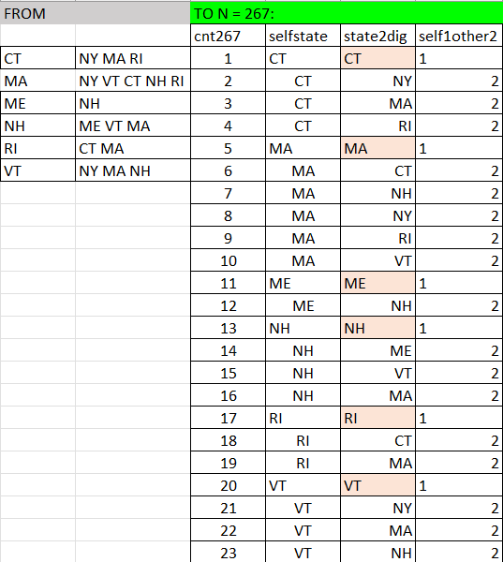
Gonzalez Griffin approach expanded to 1-to-many
Merge 2!
Merge 1- Moran I equivalent
Turn the data from n=49 to self+others -> Moran’s I becomes a Pearson correlation in the N = 218 data. N = 267 has G&G similar uses.
+++

